Slide 1




Data Science
Land Cover
Prediction
Using Machine Learning
Presented By
Muhammad Ghaza Eka Putra

Slide 2



Data Science
Overview
Background Problem Project
Predict land cover types based on environmental and topographic features.
Background data from Roosevelt National Forest, important for conservation, forest management, and regional planning.
The project aims to develop an accurate and interpretable classification model.
The project starts with preprocessing and exploratory data analysis (EDA), followed by supervised ML modeling (Random Forest, K-Nearest Neighbors, Naive Bayes, Decision Tree, Logistic Regression), and ends with model evaluation.

Slide 3
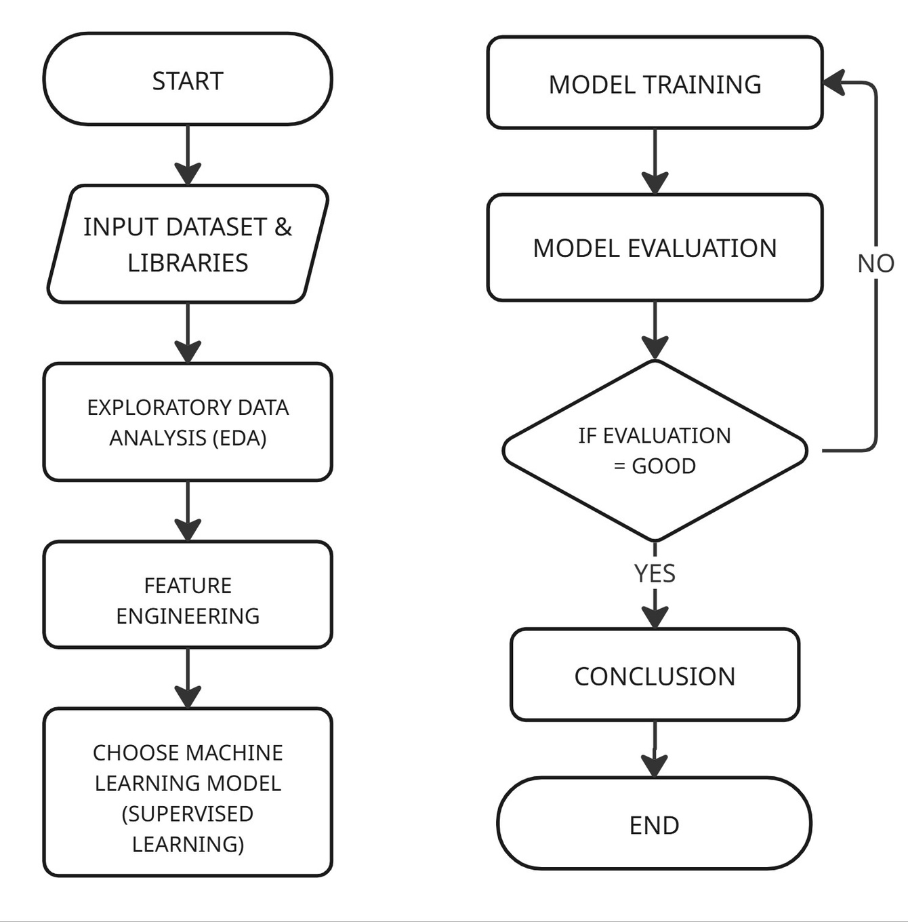
Data Science
Flowchart
Project Workflow Steps
Inputting the 'covtype.csv' dataset and importing necessary libraries
Conducting Exploratory Data Analysis (EDA), including data visualization and extracting insights
Performing feature engineering or data preprocessing such as removing duplicates, handling missing values and outliers, encoding, and feature scaling
Selecting a Machine Learning model (Supervised Learning) and performing model training
Conducting model evaluation to assess the performance of the trained model
Drawing conclusions based on the model testing results

Slide 4
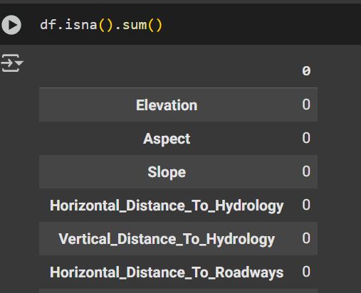
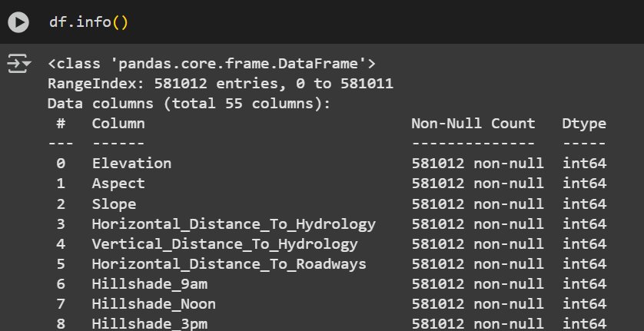
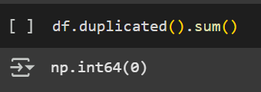
Data Science
Methodology
Exploratory Data Analysis (EDA)
Check for Duplicate
Check data, data types, and data count
Check for Missing Values
Based on the analysis, it was concluded that:
- The dataset contains no missing values
- No duplicate entries were found
- The dataset consists of 581,012 records
- It includes 54 columns

Slide 5
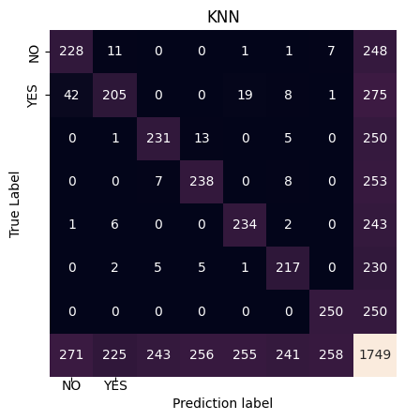
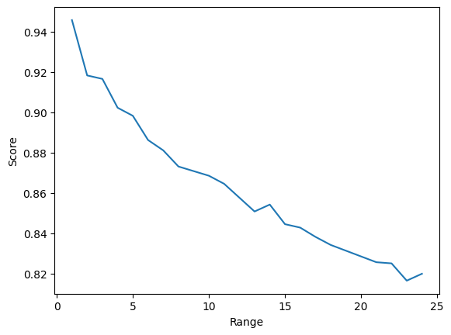
Data Science
Supervised Learning Model Evaluation
1. KKN Classification
Evaluation and Results of the Model:
TN = 228
TP = 205
FN = 42
FP = 11
Accuracy: 0.9165237278444825
Precision: 0.9173253250611456
Recall: 0.9165237278444825
F1_Score: 0.9151684502500077

Slide 6
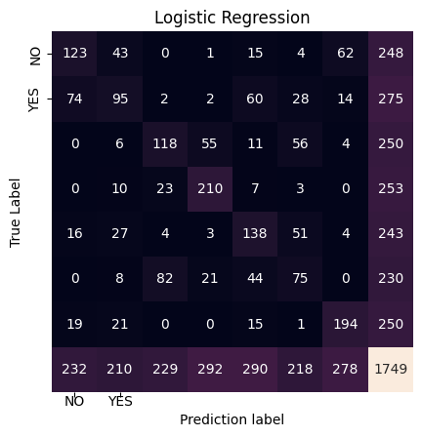
Data Science
Supervised Learning Model Evaluation
2. Logistic Regression Classification
Evaluation and Results of the Model:
TN = 123
TP = 95
FN = 74
FP = 43
Accuracy: 0.544882790165809
Precision: 0.5350965642075081
Recall: 0.544882790165809
F1_Score: 0.5371811936750959

Slide 7
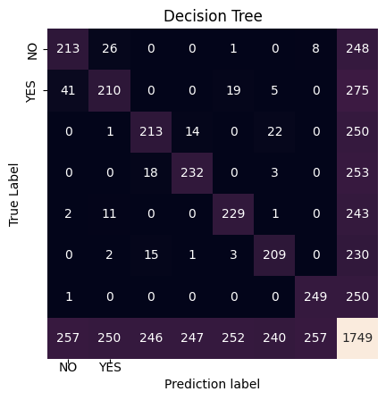
Data Science
Supervised Learning Model Evaluation
3. Decision Tree Classification
Evaluation and Results of the Model:
TN = 213
TP = 210
FN = 41
FP = 26
Accuracy: 0.8890794739851343
Precision: 0.88849107619578
Recall: 0.8890794739851343
F1_Score: 0.8883118282645875

Slide 8
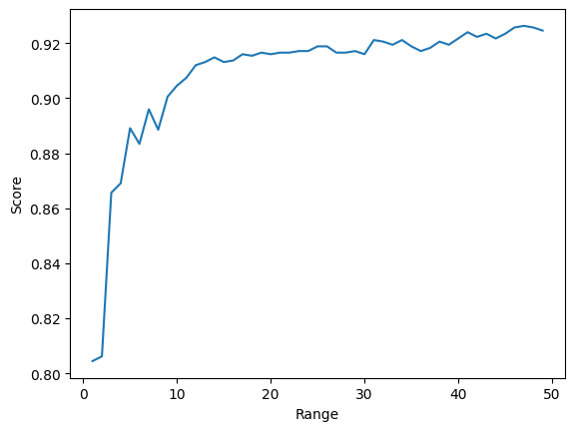

Data Science
Supervised Learning Model Evaluation
4. Random Forest Classification
Evaluation and Results of the Model:
TN = 223
TP = 225
FN = 38
FP = 20
Accuracy: 0.9256718124642653 Precision: 0.9256408802764986 Recall: 0.9256718124642653 F1_Score: 0.9252903671274441

Slide 9
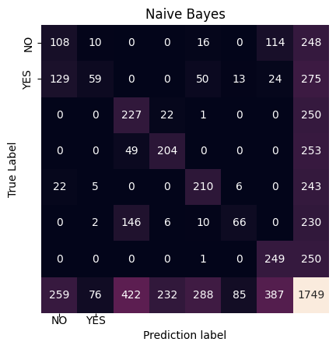
Data Science
Supervised Learning Model Evaluation
5. Naive Bayes Classification
Evaluation and Results of the Model:
TN = 108
TP = 59
FN = 129
FP = 10
Accuracy: 0.6420811892510006
Precision: 0.680659009844462
Recall: 0.6420811892510006
F1_Score: 0.608273583958254

Slide 10

Data Science
Conclusion of the Project
Summary
Based on the results, the Random Forest model achieved the highest accuracy of 0.93, supported by model evaluation showing relatively low false negatives (FN) and false positives (FP) compared to the others. This is followed by the K-Nearest Neighbors (KNN) model with an accuracy of 0.92, and the Decision Tree model with an accuracy of 0.89.
Meanwhile, the Logistic Regression model had the lowest accuracy at 0.55, with relatively high FP and FN values.
Therefore, in this case, the Random Forest, KNN, and Decision Tree models are the most suitable for predicting land cover types.

Slide 11




Data Science
Thank You
ghazaputra99@gmail.com
https://www.linkedin.com/in/muhammadghazaekaputra
https://github.com/ghaza-putra
Presented By
Muhammad Ghaza Eka Putra

